Slide 1
HTTP5204
Data Access Using Entity Framework
Lecture Notes 4

Slide 2
Learning Outcomes
Entity Framework for Data Access
Using LINQ

Slide 3
What is the Entity Framework?
The Microsoft Entity Framework is Microsoft’s recommended data access technology. It is used to build data models.
The Microsoft Entity Framework (in part) is an Object Relational Mapping (ORM) tool.
For example, if you have a database table named Employee, you can use the Microsoft Entity Framework to generate a class named Employee that represents a particular row from the table.
In your code, instead of interacting with the Employee database directly, you interact with the Entity Framework object context and the Employee class.
The Entity Framework shields you from needing to interact directly with the database.
By taking advantage of the Entity Framework, you never need to write SQL queries again. You can write all your data access code in C# or VB.NET instead of SQL.

Slide 4
Working with DbContext
The primary class that is responsible for interacting with data as objects is System.Data.Entity.DbContext (often referred to as context).
We create the context classes (DbContext Class). The DbContext object is responsible for performing all the CRUD (Create, Read, Update, Delete) operations on the models when it has the DbSet defined.
The recommended way to work with context is to define a class that derives from DbContext and exposes DbSet properties that represent collections of the specified entities in the context.

Slide 5
Working with DbContext
In our Model classes we define the properties that we want to keep in our models. We identify the model class with the table in our database.
We create the context classes (DbContext Class). The DbContext object is responsible for performing all the CRUD (Create, Read, Update, Delete) operations on the models when it has the DbSet defined.
With the DbContext class ready, the only question left is where this data will be stored. We use the ConnectionString to specify the location and meta data of the database that the DbContext class should use. (The name of the connection string is the same name as the db context class)
You will be using a DbContext object to get access to your tables and views (which will be represented by DbSet's) and you will be using your DbSet's to get access, create, update, delete and modify your table data.

Slide 6
Working with a DbContext derived class
Accessing a DbSet property on a context object represent a starting query that returns all entities of the specified type. A query is executed when:
It is enumerated by a foreach (C#) statement.
It is enumerated by a collection operation such as ToList.
LINQ operators such as First are specified in the outermost part of the query.

Slide 7
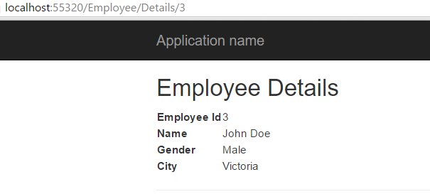
Running your Application

Slide 8
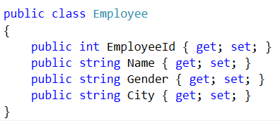
Data Access using Entity Framework
The controller responds to URL request, gets data from a model and hands it over to the view. The view then renders the data. Model can be entities or business objects.
We have built an Employee entity.
We will retrieve data from a database table (Employeetbl) using Entity Framework.

Slide 9
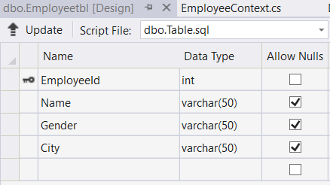
Create a Database with a Table
Right-click App_Data→ Add New Item
Add an SQL Server Database (EmployeeDB.mdf)
Add new table (Employeetbl)
Notes:
(update..database)

Slide 10
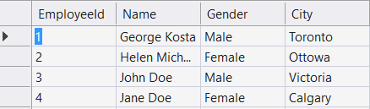
Populate your database table with some data

Slide 11
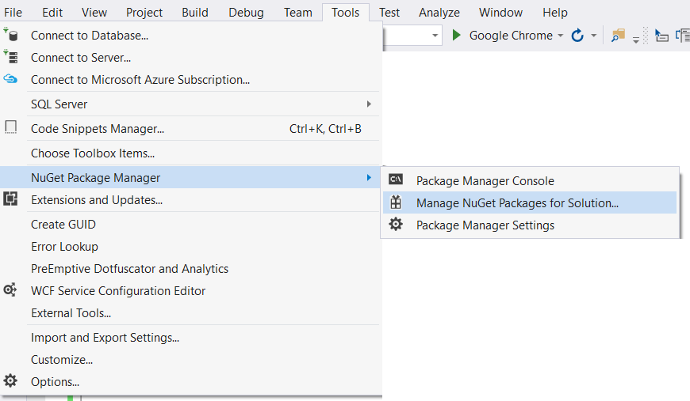
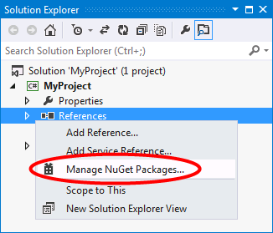
Step 1: Install entity framework using nugget package manager.
You can install the EntityFramework package by going to Tools, NuGet Pacakage Manager, Manage NuGet Packages for Solutions…
You can install the EntityFramework package by right-clicking on the References folder of your project and selecting Manage NuGet Packages…
you can install EntityFramework by running the following command in the Package Manager Console.

Slide 12
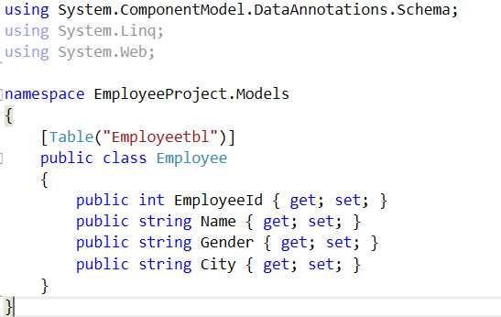
Step 2: Map "Employee" model class to the database table, Employeetbl using "Table" attribute
Notes:
Ctrl+ .

Slide 13
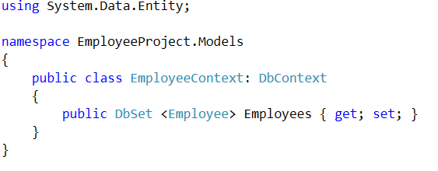

Step 3: Add EmployeeContext.cs class file to the Models folder.
Establish connection to our database

Slide 14
Step 4: Add a connection string to the Web.config file, in the root directory.
By default, the Entity Framework looks for a connection string named the same as the object context class
Notes:
server=.; database=Sample; integrated security=SSPI

Slide 15
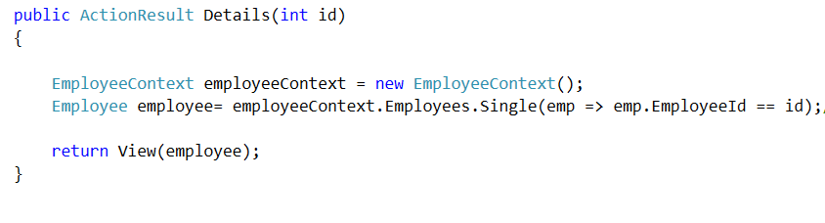
Step 5: Make the changes to "Details()" action method in "EmployeeController"
You use a LINQ query when retrieving a single record.

Slide 16
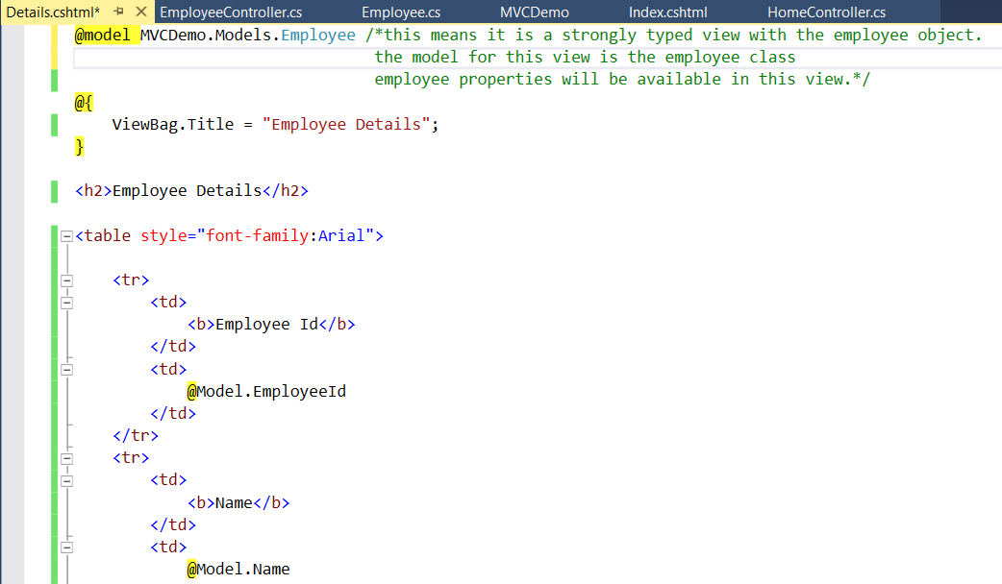
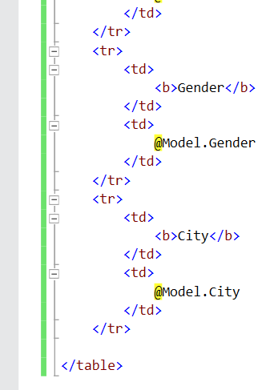

Slide 17
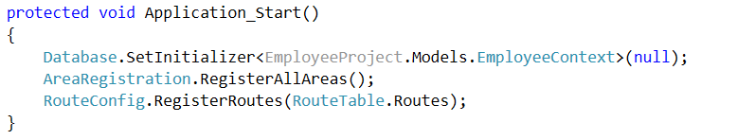
Step 6: paste the following code in Application_Start() function, in Global.asax file. Database class is present "in System.Data.Entity" namespace. Existing databases do not need database initializer so it can be turned off.

Slide 18
Running your Application

